Slide 1

IIAAG
Middle School Bowling League 2026
Team Officials and Coaches meeting
Organized by: Guam Bowling Congress

Slide 2


MEETING AGENDA
Call to Order
II. Introductions
IIAAG Officials
Team Officials
Team Coaches
League Coordinator and Official
Organized by:
MIDDLE SCHOOL BOWLING LEAGUE 2026

Slide 3







MEETING AGENDA
III. League Format and Rules
  Participating Schools
    Andersen Middle School
    Dominican Catholic Schools
    Harvest Christian Academy
    McCool Middle School
    SIFA Learning Academy Charter School
    St. John’s School
    St. Anthony Catholic School
Organized by:
MIDDLE SCHOOL BOWLING LEAGUE 2026

Slide 4
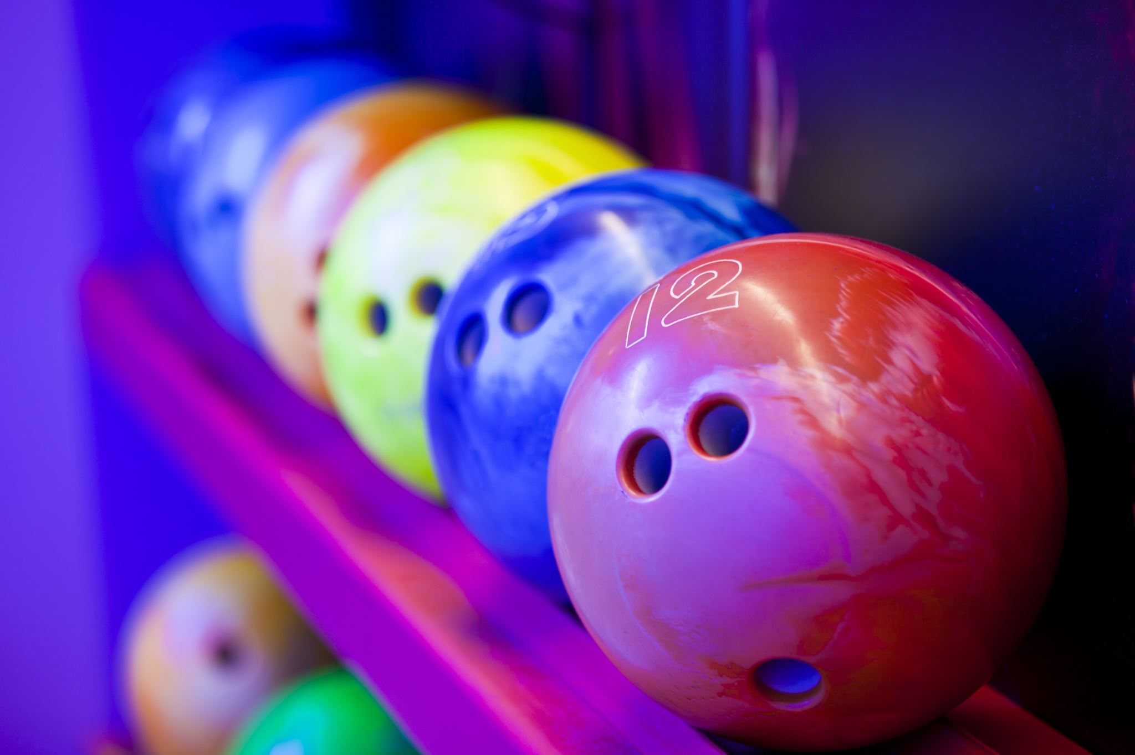
MEETING AGENDA
III. League Format and Rules
  B. Eligibility
  C. Schedule of Events
  D. League Format
    Bowling format
    Roster
    Scoring format
      Scoresheet
      Results
  E. Fee Collection
  a. Practice Sessions
  b. League Sessions
Organized by:
MIDDLE SCHOOL BOWLING LEAGUE 2026

Slide 5
ELIGIBILITY
MEETING AGENDA
To be eligible for the IIAAG Middle School program, students must meet certain academic and citizenship requirements. Here are some key points:
Academic Eligibility: Students must maintain an overall average of 70% or better in all subjects for the quarter prior to participation. Additionally, students cannot have an "F" (59% or below) in any subject, regardless of their overall grade.
Grade Checks: The Athletic Director will check academic and citizenship grades at the end of each quarter.
Additional Requirements: Students must complete and submit an IIAAG Middle School Athlete Packet to the coach on the first day of attending practice or tryouts. They will not be able to participate or attend practice/tryouts until cleared by the Athletic Director.
Organized by:
MIDDLE SCHOOL BOWLING LEAGUE 2026

Slide 6
COMPETITION SCHEDULE
MEETING AGENDA
Week No. | Day and Dates | Event/Format
 | February 16-April 12, 2026 | Official Practice Sessions
1 | Monday, April 13, 2026 | Opening Ceremony and Singles Competition
2 | Monday, April 20, 2026 | Bakers Team Competition
3 | Monday, April 27, 2026 | Singles Competition
4 | Monday, May 4, 2026 | Bakers Team Competition
5 | Monday, May 11, 2026 | All-Island Singles Competition
6 | Tuesday, May 12, 2026 | All-Island Bakers Team Competition
Organized by:
MIDDLE SCHOOL BOWLING LEAGUE 2026

Slide 7

LEAGUE FORMAT
MEETING AGENDA
    Bowling format
    Roster
    Scoring format
      Scoresheet
      Results
See Middle School Bowling League 2026
Rules and Regulations booklet.
Organized by:
MIDDLE SCHOOL BOWLING LEAGUE 2026

Slide 8
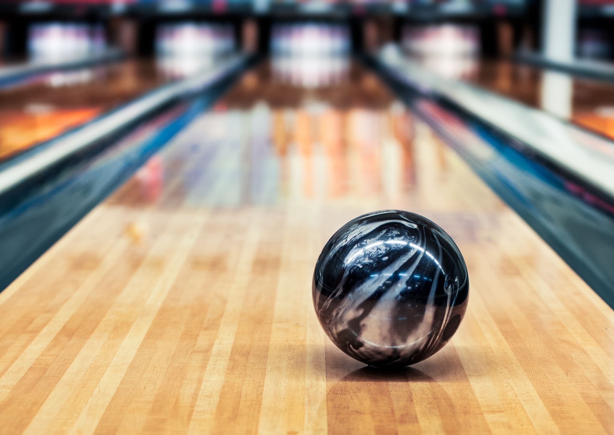
MEETING AGENDA
FEE COLLECTION
It is the responsibility of the Team official (coach/manager) to collect fees and make payment before practice/competition to the bowling counter personnel.
Organized by:
MIDDLE SCHOOL BOWLING LEAGUE 2026

Slide 9
MEETING AGENDA
League Format and Rules
  F. All Island Event
  a. Qualifying Process
  b. Format
  c. Date, Time and Venue
  d. Fees
  e. Awards
Organized by:
MIDDLE SCHOOL BOWLING LEAGUE 2026

Slide 10
LEAGUE FORMAT
MEETING AGENDA
SINGLES COMPETITION
Coaches will be given their school’s assigned lanes and shall provide a line up a day before the competition to the Competition Manager.
Each competitor will bowl two games on the assigned pair of lanes.
Competitors are competing against the entire field and will be awarded points based on their overall standings.
Team Points Calculation for the Singles Event:
Team points will be determined based on the performance of the top four bowlers from each school.
The combined performance of these top four bowlers will establish the overall point system for that week's competition.
Organized by:
MIDDLE SCHOOL BOWLING LEAGUE 2026

Slide 11
LEAGUE FORMAT
MEETING AGENDA
Bakers Team Competition | Coaches will be given their school’s assigned lanes and shall provide a Bakers Team (four-player) line up per assigned lane a day before the competition to the Competition Manager. Each Bakers Team will bowl a total of 8 Bakers games on the assigned pair of lanes. Teams are competing against the entire field and will be awarded points based on their overall standings. Game Play: Instead of each player bowling a complete game individually, they rotate frames. Player 1 bowls the 1st frame, Player 2 bowls the 2nd frame, and so on. Once all team members have bowled, Player 1 starts again with the 5th frame, and this rotation continues until all 10 frames are completed. Frame Assignment for a team of four: Player 1 bowls frames 1, 5, and 9. Player 2 bowls frames 2, 6, and 10. Player 3 bowls frames 3 and 7. Player 4 bowls frames 4 and 8.
Organized by:
MIDDLE SCHOOL BOWLING LEAGUE 2026

Slide 12
LEAGUE FORMAT
MEETING AGENDA
Bakers Team Competition | Scoring The team's score is the combined effort of all members' performance. Since each player bowls a limited number of frames, teamwork and strategy become crucial. Teams often assign stronger bowlers to critical frames (like the 10th frame) to maximize their scoring potential. Strategy Teams may strategize their lineup based on their players' strengths. Placing the most consistent or clutch bowler in the 10th frame can be a common strategy to finish strong. Benefits The Baker format emphasizes team coordination, communication, and strategy. It creates a dynamic and engaging competition as every bowler's contribution directly impacts the team's overall performance. Team Points Calculation for the Bakers Event Team points will be determined based on the performance of the top Bakers team from each school.
Organized by:
MIDDLE SCHOOL BOWLING LEAGUE 2026

Slide 13
ALL ISLAND SINGLES COMPETITION
Monday, May 11, 2026, at 4:00 p.m.
MEETING AGENDA
The top 30 boys and 30 girls will compete in a three-game bowling event, with qualification based on their singles event average after participating in at least one singles event and one Baker's Team event. In the all-island singles finals, scratch scores will be totaled, and medals will be awarded to the top 10 finalists.
In the event of a tie for players in the top 10, a one ball roll-off will be bowled on lanes designated by the Guam Bowling Congress official. A coin flip will determine which player will bowl first. If a tie after the one ball roll-off still exists, the roll-ff continues with bowlers alternating lanes.
The top 3 in the boy’s and girls’ divisions will advance to a stepladder to determine the all-island champion. Match 1 (semi-finals) the #3 ranked player and #2 ranked player will bowl one game to determine the finalist challenger to compete against the #1 top seed. The winner of the finals will be declared the all-island champion.
In the event of a tie during match play, a one ball roll-off will commence with the higher seed choosing the order.
Organized by:
MIDDLE SCHOOL BOWLING LEAGUE 2026

Slide 14
ALL ISLAND TEAM COMPETITION
MEETING AGENDA
Tuesday, May 12, 2026, at 4:00 p.m.
The Team championship will be determined upon completion of the competition. The event will be a 4-person baker format as simulated during the regular season. During the finals, only (1) one 4-person team from each school is allowed to participate. Coaches will submit lineups for the competition 24-hours prior to the event.
We have 6 schools participating, the playoff matches will be determined by regular season seeding.
Competition Matches:
Round 1 | Round 2 | Round 3
1st seed (bye) 2nd seed (bye) 3rd seed vs. 6th seed 4th seed vs. 5th seed | 1st seed vs. the lower ranked of the winning seeds in Round 1 2nd seed vs. the higher ranked of the winning seeds in Round 1 | Championship Match Winners from Round 2 Consolation Match Non-winners from Round 2
Organized by:
MIDDLE SCHOOL BOWLING LEAGUE 2026

Slide 15
ALL ISLAND TEAM COMPETITION
MEETING AGENDA
The matches will be a best of 3 format. The first team to win two matches will advance to the next round. If a team wins 2-0, that team will wait until all matches are complete before proceeding to the next match. In the event the games are 1 win each, a third game will be bowled.
In the event of a tie after a playoff baker game: a one ball roll-off will be done. Coaches may choose any player of the four to roll the tie-breaking shot. The higher seeded team will determine the order of the roll-off, the lower seed will determine which lane to start the roll-off. If a tie continues after the one-ball roll-off, the players will alternate lanes until a winner is determined.
During the baker team event, the order can be changed after each game. For example, the player that bowls 1st during game 1 can be moved to bowl 2nd in game 2.
Organized by:
MIDDLE SCHOOL BOWLING LEAGUE 2026

Slide 16
MEETING AGENDA
Question & Answer session
Contact Information
Jay Leon Guerrero, League Coordinator 671-777-4811
Joey Miranda III, GBC Secretary-General 671-787-2462
VI. Adjournment
Organized by:
MIDDLE SCHOOL BOWLING LEAGUE 2026

Slide 17

MEETING AGENDA
Organized by:
HIGH SCHOOL BOWLING LEAGUE 2026

